Slide 1
Nevada bar application
Understanding the Basics (as of the July 2024 exam)

Slide 2
Basic overview
The first three steps to getting started on the bar exam application (explained in-depth with links on the following slides)
Read the Instructions for Applicants
Register for the Bar Exam
Complete the Bar Application
Starting point
https://nvbar.org/licensing-compliance/admissions/admissions-online-application/

Slide 3
Step 1: Detailed instructions
NV provides an in-depth set of instructions for applicants
https://nvbar.org/wp-content/uploads/2024-INSTRUCTIONS-TO-APPLICANT.pdf
Highlights include
Fees
Graduation Requirements
Required Documentation
Exam Time + Place

Slide 4
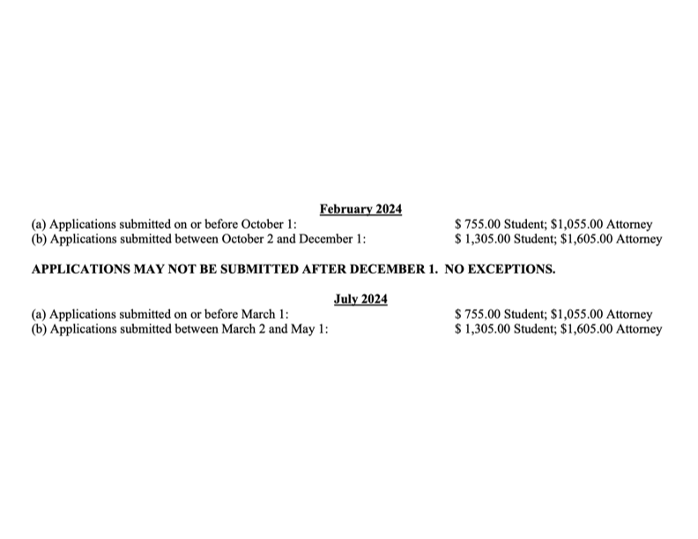
Quick preview: Fees
NV provides 2 deadlines for each administration of the exam
The second deadline is considered “late,” and applicants will pay an additional $550 fee
$150 computer fee if you wish to take the essay portion on your laptop

Slide 5
Quick preview: other required documentation
After submitting the online application, applicants will receive an email from admissions
This email will include instructions about which additional materials must be returned to admissions within 21 days of the date the email is sent by the Admissions Department
Some materials must be mailed; others may be emailed
This includes (not a comprehensive list)
School transcripts
DMV Reports
Letters of Reference

Slide 6
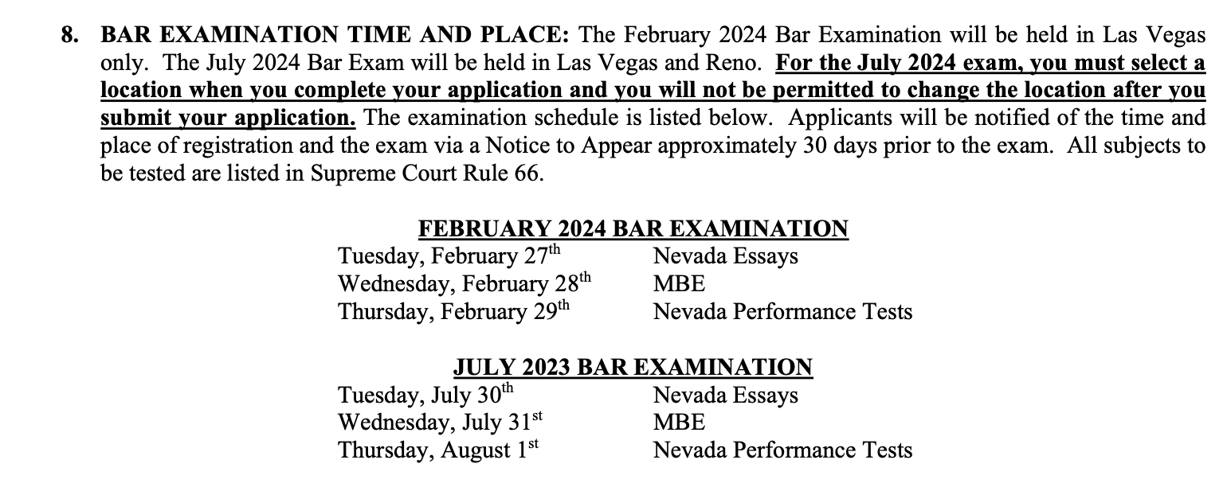
Quick preview: exam time + Place

Slide 7
Step 2: Register for the exam
Once you have read the initial instructions document, the next step is to register for the exam
To register for the NV bar exam, navigate to the Online Application for Admission
https://admissions.nvbar.org/cvweb/cgi-bin/utilities.dll/openpage?wrp=mainlogin.htm

Slide 8
How to register your online account
For detailed instructions on how to get registered with your online account, follow these instructions:
https://app.tango.us/app/workflow/Navigating-the-Bar-Examination-Online-Application-Process--Part-1--ada6f394767f43eb82fa60f27912e95e

Slide 9
Step 3: Complete your online application
NV provides applicants a step-by-step tutorial (with visuals) walking applicants through the entire application
https://app.tango.us/app/workflow/Completing-the-Bar-Application--A-Step-by-Step-Process-b79a2680a57b45729bf2a794590066cb
Also provided is a video overview of the application process
https://www.youtube.com/watch?v=ki16VuUUdPo

Slide 10
Application breakdown
There are 4 general steps to the NV bar application
(1) Pay the Initial Application Fee
(2) Complete the Application
(3) Pay Final Fee & Submit Application
(4) Supplemental Admissions Materials

Slide 11
fitness and moral character
Character and Fitness is contained within the NV app itself; there is no separate application
Included in the Fitness and Moral Character application section:
Financial Section
Personal Conduct or Behavior
General Questions

Slide 12
MPRE
Must have received a score of 85 or higher on the MPRE within the past three calendar years
Must have taken the MPRE no later than three years prior the exam the application is sitting for
Have 3 years after sitting for the exam and receive a scaled score of 85 or higher
If the applicant has not taken/passed the MPRE when they take/pass the NV bar exam, admissions will hold the application for up to 3 years
After 3 years, the applicant’s application is withdrawn

Slide 13
fingerprinting
Admissions will email you after the submission of your initial application with instructions regarding fingerprinting
Do not submit or complete any of the forms until you have received emailed instructions from the admission department
Instructions for fingerprinting are found in the “Admissions Forms” section of the State Bar Website
https://nvbar.org/licensing-compliance/admissions/forms/

Slide 14
Contact information
STATE BAR OF NEVADA
Admissions Department 3100 W. Charleston Blvd., Suite 100 Las Vegas, NV 89102
Website: www.nvbar.org
Email: admissions@nvbar.org

